Slide 1

Jared Bennett MIS 665 – Final Project Presentation

Slide 2
Description and Purpose
The dataset is being used to find the characteristics/factors that have an impact on fans renewing their season tickets.
The purpose of this project is to determine the characteristics that describe people who might not renew the season tickets.

Slide 3
Analysis and Findings
Visual Analysis concluded that the variables that held the most weight were Age of the ticket holders, Years they had been ticket holders, Income of the ticket holders, and Backer status (whether or not the ticket holder was a Backer).
The testing of variables was done by looking at histograms, pivot tables, and scatter and bar plots
The income, backer and years variables had the most affect on each other and on the testing methods, with backer and income being weighed the most heavily.
The models used to test the variables were the Decision Tree Model and Logistic Regression

Slide 4
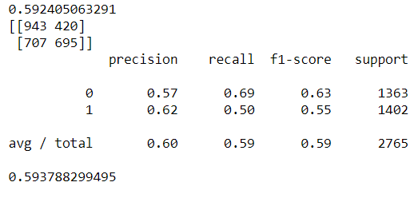
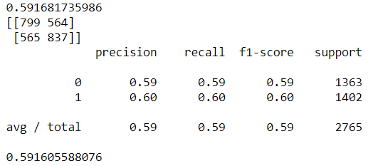
Model Details
Decision Tree:
Used the Backer, Income, and Years variables against the Y2Defect variable
Logistic Regression:
Used Backer, Income, Age and Years variables against Y2Defect variable

Slide 5
Conclusions
Based on the data, Age, Years being a ticket holder, Backer status, Income, and Gender are the biggest factors pertaining to who would defect.
Non backers gradually stop buying tickets, the longer they hold season tickets.
The more income a backer had, the more likely they were to be season ticket holders longer
Those most likely to defect were both male and female, non-backers who had been ticket holders for 6 years or more.

Slide 6
Recommendations
I would recommended that the Athletic Department look into making the benefits of being a backer more alluring, while looking into offering benefits to fans who hold season tickets for more that 5 years.

